Slide 1

Shri Vaishnav Vidyapeeth Vishwavidyalaya
Shri Vaishnav Institute of Information Technology
Department of Computer Science Engineering
AlluminiConnect
Software Requirements Specification & Conceptual Design
Mentor: Dr. Avdesh Kumar Sharma
Submitted by: Aryan Gore
Jayesh Khatke
Course Teacher: Prof. Varsha Choudhary

Slide 2
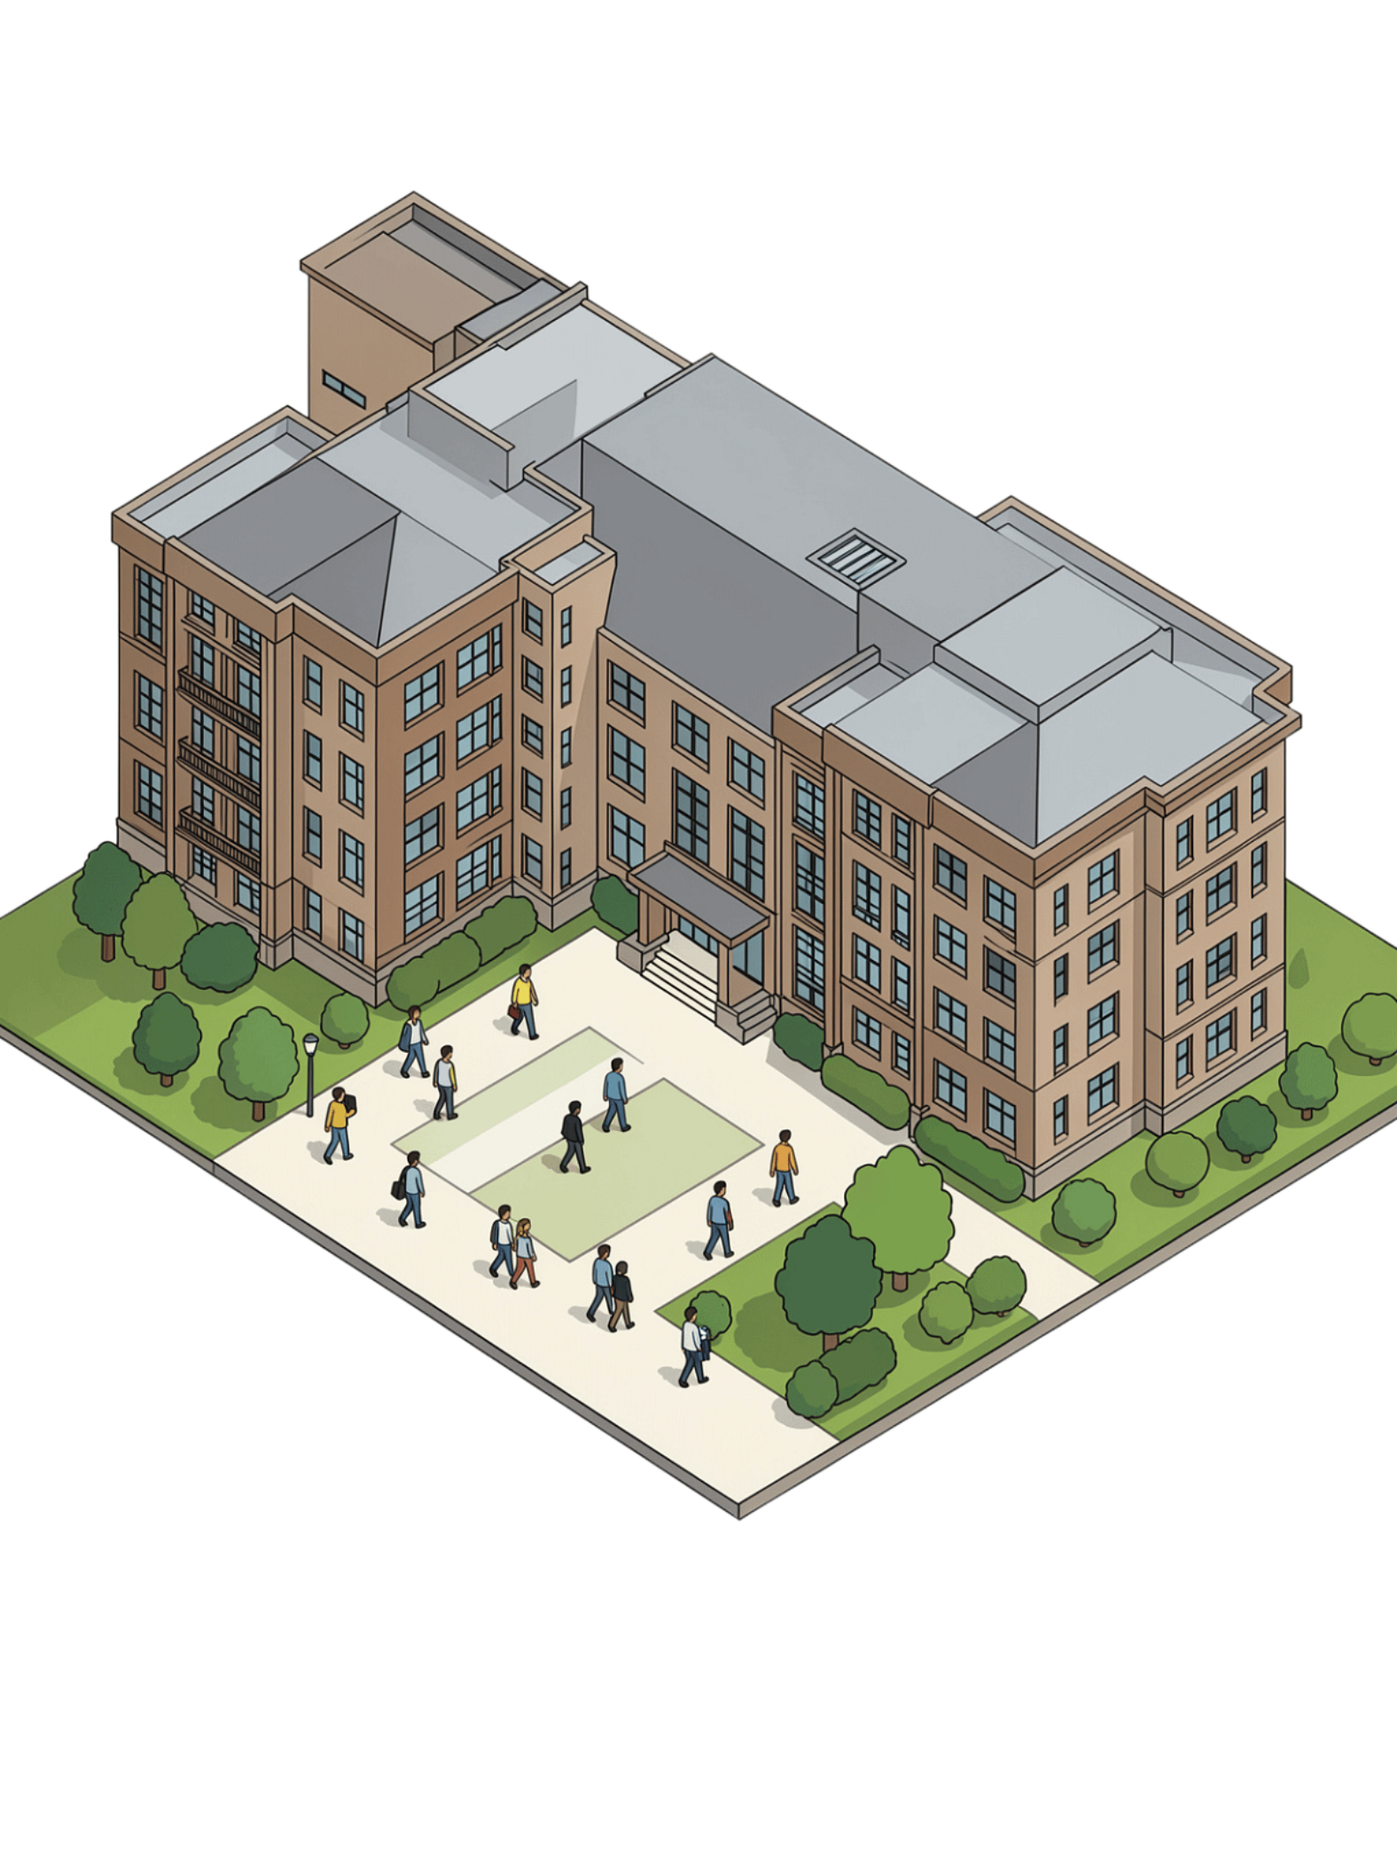
AlumniConnect
Digital Platform for Centralized Alumni Data Management and Engagement
Connecting Students, Alumni & Institution Through One Digital Platform

Slide 3

The Alumni Data & Engagement Gap
No Centralized System
Alumni data scattered across spreadsheets, emails, and personal devices with no single source of truth.
AlumniConnect
Poor Communication
Digital Platform for Centralized Alumni Data Management and Engagement
Connecting Students, Alumni & Institution Through One Digital Platform
Institutions rely on WhatsApp groups and outdated mailing lists to reach alumni communities.
Lost Connections
Difficult to locate alumni or maintain updated contact information as careers evolve.
Missed Opportunities
Student-alumni networking, mentorship, and engagement remain fragmented and unstructured.

Slide 4

Purpose & Scope
Purpose: Define functional and non-functional requirements governing AlumniConnect's development.
Scope: Two core pillars — centralized alumni data management and structured alumni engagement — extended with a professional networking layer (rich profiles, skills-based search) and a communication layer (direct messaging, community feed).

Slide 5
User Classes & Characteristics
Role | Description | Key Capabilities
Public User | Unauthenticated visitor | View landing page, register as student, claim alumni profile
Student | Currently enrolled student | Search directory, request mentorship, browse events/jobs
Alumni | Graduated user with a claimed profile | Maintain profile, mentor students, post jobs, message connections
Admin | Institutional staff | Manage records, moderate content, view analytics, publish announcements

Slide 6
Non-Functional Requirements
Category | Requirement
Security | JWT-based stateless authentication; role-based access control; bcrypt password hashing
Performance | Directory search returns results within acceptable response time at institution scale
Usability | Responsive layout across desktop and mobile browsers
Availability | Backend degrades gracefully (falls back to raw data) if analytics service is unreachable
Maintainability | Three-tier architecture with clear separation of concerns
Scalability | Normalized relational schema designed to support growth in alumni and engagement records

Slide 7
Functional Requirements: Engagement
1
FR-8
Searchable directory filterable by department, batch, year, company, industry, location, and skill.
2
FR-9
Students shall send mentorship requests to alumni open to mentoring.
3
FR-10
Alumni shall accept, reject, or mark mentorship requests complete.
4
FR-11
Admins shall create, publish, and cancel events with defined capacity.
5
FR-12
Users shall register for and cancel event registration, enforcing capacity limits.
6
FR-13
Alumni shall post job opportunities, subject to admin moderation.
7
FR-14
Admins shall publish announcements targeted by audience (all, students, alumni, department, or batch).

Slide 8
Functional Requirements: Data Management
1
FR-1
Admins shall manually add individual alumni records.
2
FR-2
Admins shall bulk-import via CSV/Excel with column mapping, validation, and duplicate detection.
3
FR-3
Alumni shall claim existing records by verifying enrollment number, email, and graduation year.
4
FR-4
The system shall prevent duplicate alumni record creation during the claim process.
5
FR-5
The system shall distinguish institution-controlled fields from alumni-controlled fields and enforce write permissions accordingly.
6
FR-6
The system shall organize departments under their parent institute (e.g., Engineering, Management, Science).
7
FR-7
The system shall support per-field visibility (Public / Alumni-only / Private) for alumni email and phone number.

Slide 9
Requirement Prioritization — MoSCoW
Must Have | Authentication, alumni directory, CSV import & claim workflow, admin record management
Should Have | Mentorship, events, jobs, announcements, notifications
Could Have | Direct messaging, community feed, extended profile (education/projects/certifications), Google OAuth
Won't Have | Donation/fundraising management, AI-based mentor matching

Slide 10

Conceptual Design: System Architecture
Frontend
Analytics
Backend
Database
Three-tier core: React/Vite frontend, Spring Boot REST backend, MySQL relational database. An internal-only Python/FastAPI service handles data cleaning and statistical analysis, called exclusively by the backend. Communication: REST/JSON over HTTPS for standard requests; WebSocket (STOMP) for real-time messaging.

Slide 11
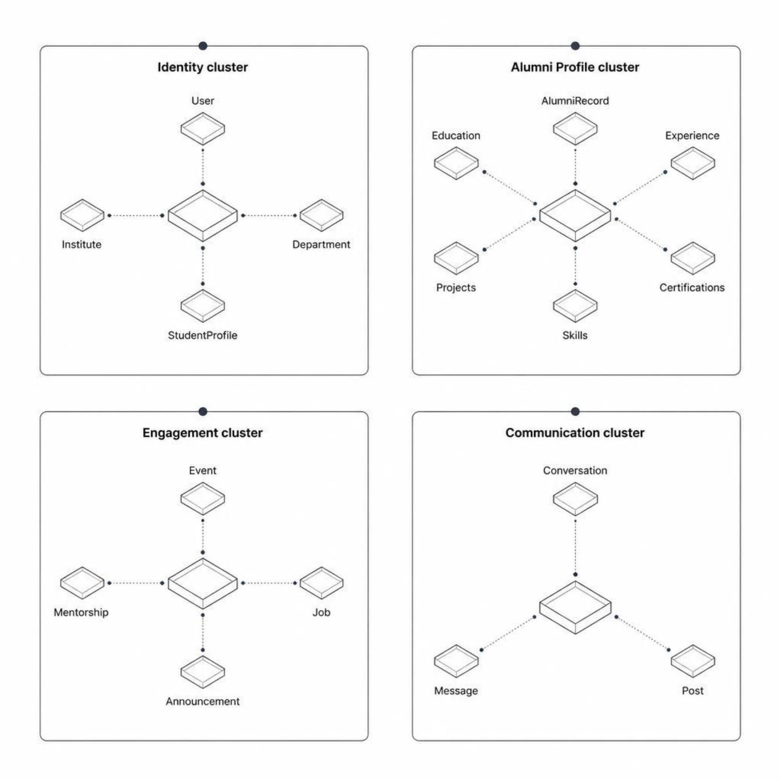
Conceptual Design: Data Model Overview
27-table relational schema
with 35 foreign-key
relationships across
four entity clusters.

Slide 12
THANK YOU!

